Slide 1

https://github.com/abdullah-141/Frozen_AI

Slide 2
Team Name : Frozen Voltage
Project Name : Unfrozen School
Team members:
1.Md. Shahriar Kamal 2.Md Rabby Hossain
3.Md Abdullah Sikder

Slide 3

PROBLEMS
SOLUTION
FEATURES
TECH STACK
FUTURE SCOPE
Lack of personalized learning tools

Slide 4
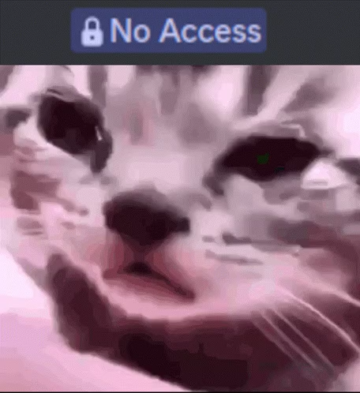
PROBLEMS
SOLUTION
FEATURES
TECH STACK
FUTURE SCOPE
2. Limited access to interactive and engaging content

Slide 5
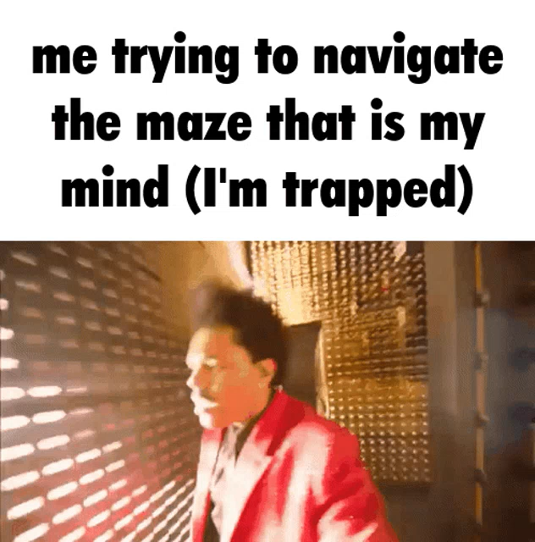
PROBLEMS
SOLUTION
FEATURES
TECH STACK
FUTURE SCOPE
3. Fragmented educational resources

Slide 6

PROBLEMS
SOLUTION
FEATURES
TECH STACK
FUTURE SCOPE
4. Outdated or inaccessible information on admissions and circulars

Slide 7

PROBLEMS
SOLUTION
FEATURES
TECH STACK
FUTURE SCOPE
5. Difficulty in visualizing and understanding complex concepts

Slide 8
PROBLEMS
SOLUTION
FEATURES
TECH STACK
FUTURE SCOPE
6. Limited support for inclusive learning

Slide 9
PROBLEMS
SOLUTION
FEATURES
TECH STACK
FUTURE SCOPE
1. AI-driven personalized education pathways 2. Interactive and immersive learning experiences 3. Unified access to diverse academic resources 4. Real-time updates on academic opportunities 5. Simplified understanding of complex topics 6. Inclusive tools for diverse learning needs

Slide 10
PROBLEMS
SOLUTION
FEATURES
TECH STACK
FUTURE SCOPE
1. Chat with book, visual Q\&A, and AI-generated quizzes 2. SciTales: Story-based concept explanations 3. Flowcharts and diagrams generated by AI 4. Virtual labs and lab manuals for hands-on learning 5. Admission circulars and notification system 6. Voice command, sign language tutorials, and audiobooks

Slide 11




PROBLEMS
SOLUTION
FEATURES
TECH STACK
FUTURE SCOPE
React
Gemini
Firebase Studio
NodeJS
Google’s AI model to perform Generative tasks
Live preview and debugging. Assistance while coding
User Interface and User Interaction
Logic handling and API management

Slide 12
PROBLEMS
SOLUTION
FEATURES
TECH STACK
FUTURE SCOPE
1. Support for more regional and local languages 2. Simple gamification features to make learning more engaging 3. Basic integration of AR/VR for select topics and experiments 4. Smarter content suggestions based on student progress 5. Tools for students to collaborate and discuss topics 6. Dashboard for teachers to track student activity and performance

Slide 13
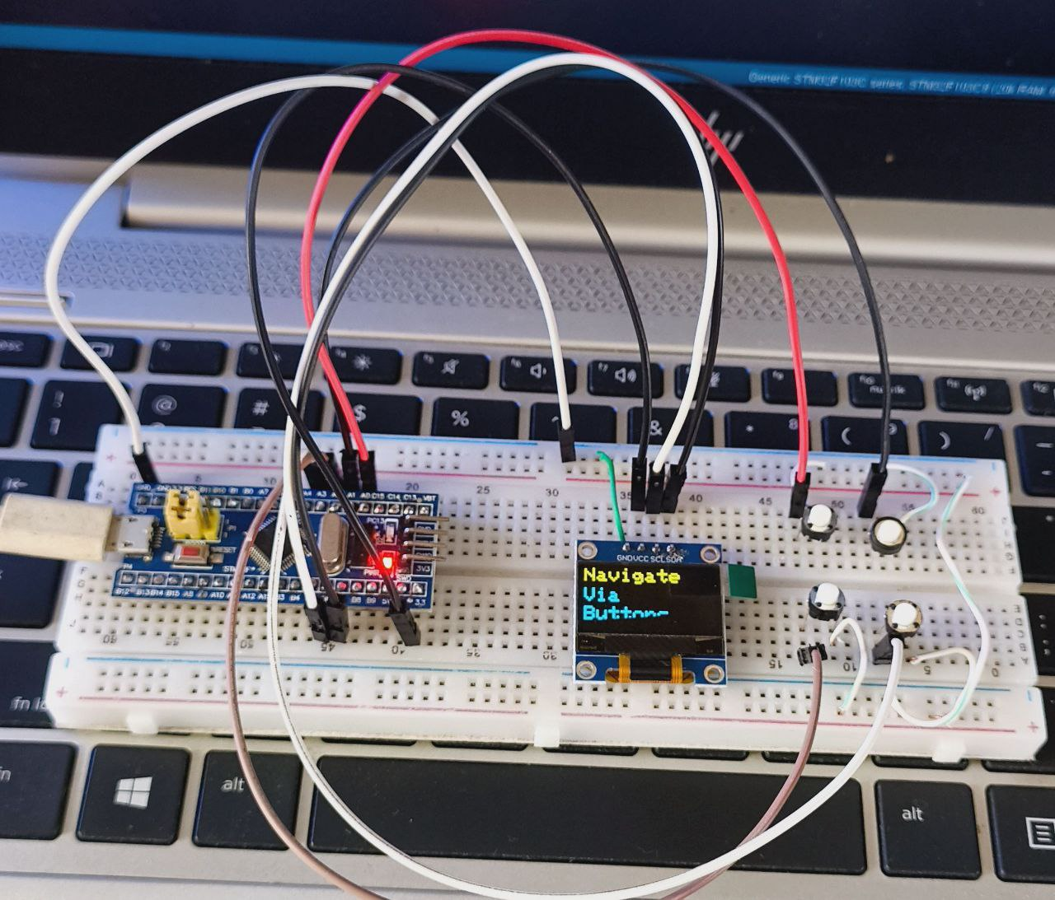
PROBLEMS
SOLUTION
FEATURES
TECH STACK
FUTURE SCOPE
Problem: Disabled individuals face challenges navigating and interacting with online educational content.
Solution: An IoT-assisted web platform where a physical 4-button system (STM32-based) allows disabled users to:
Search topics
Listen to website content via Text-to-Speech
Navigate between sections
Stop/skip reading

Slide 14
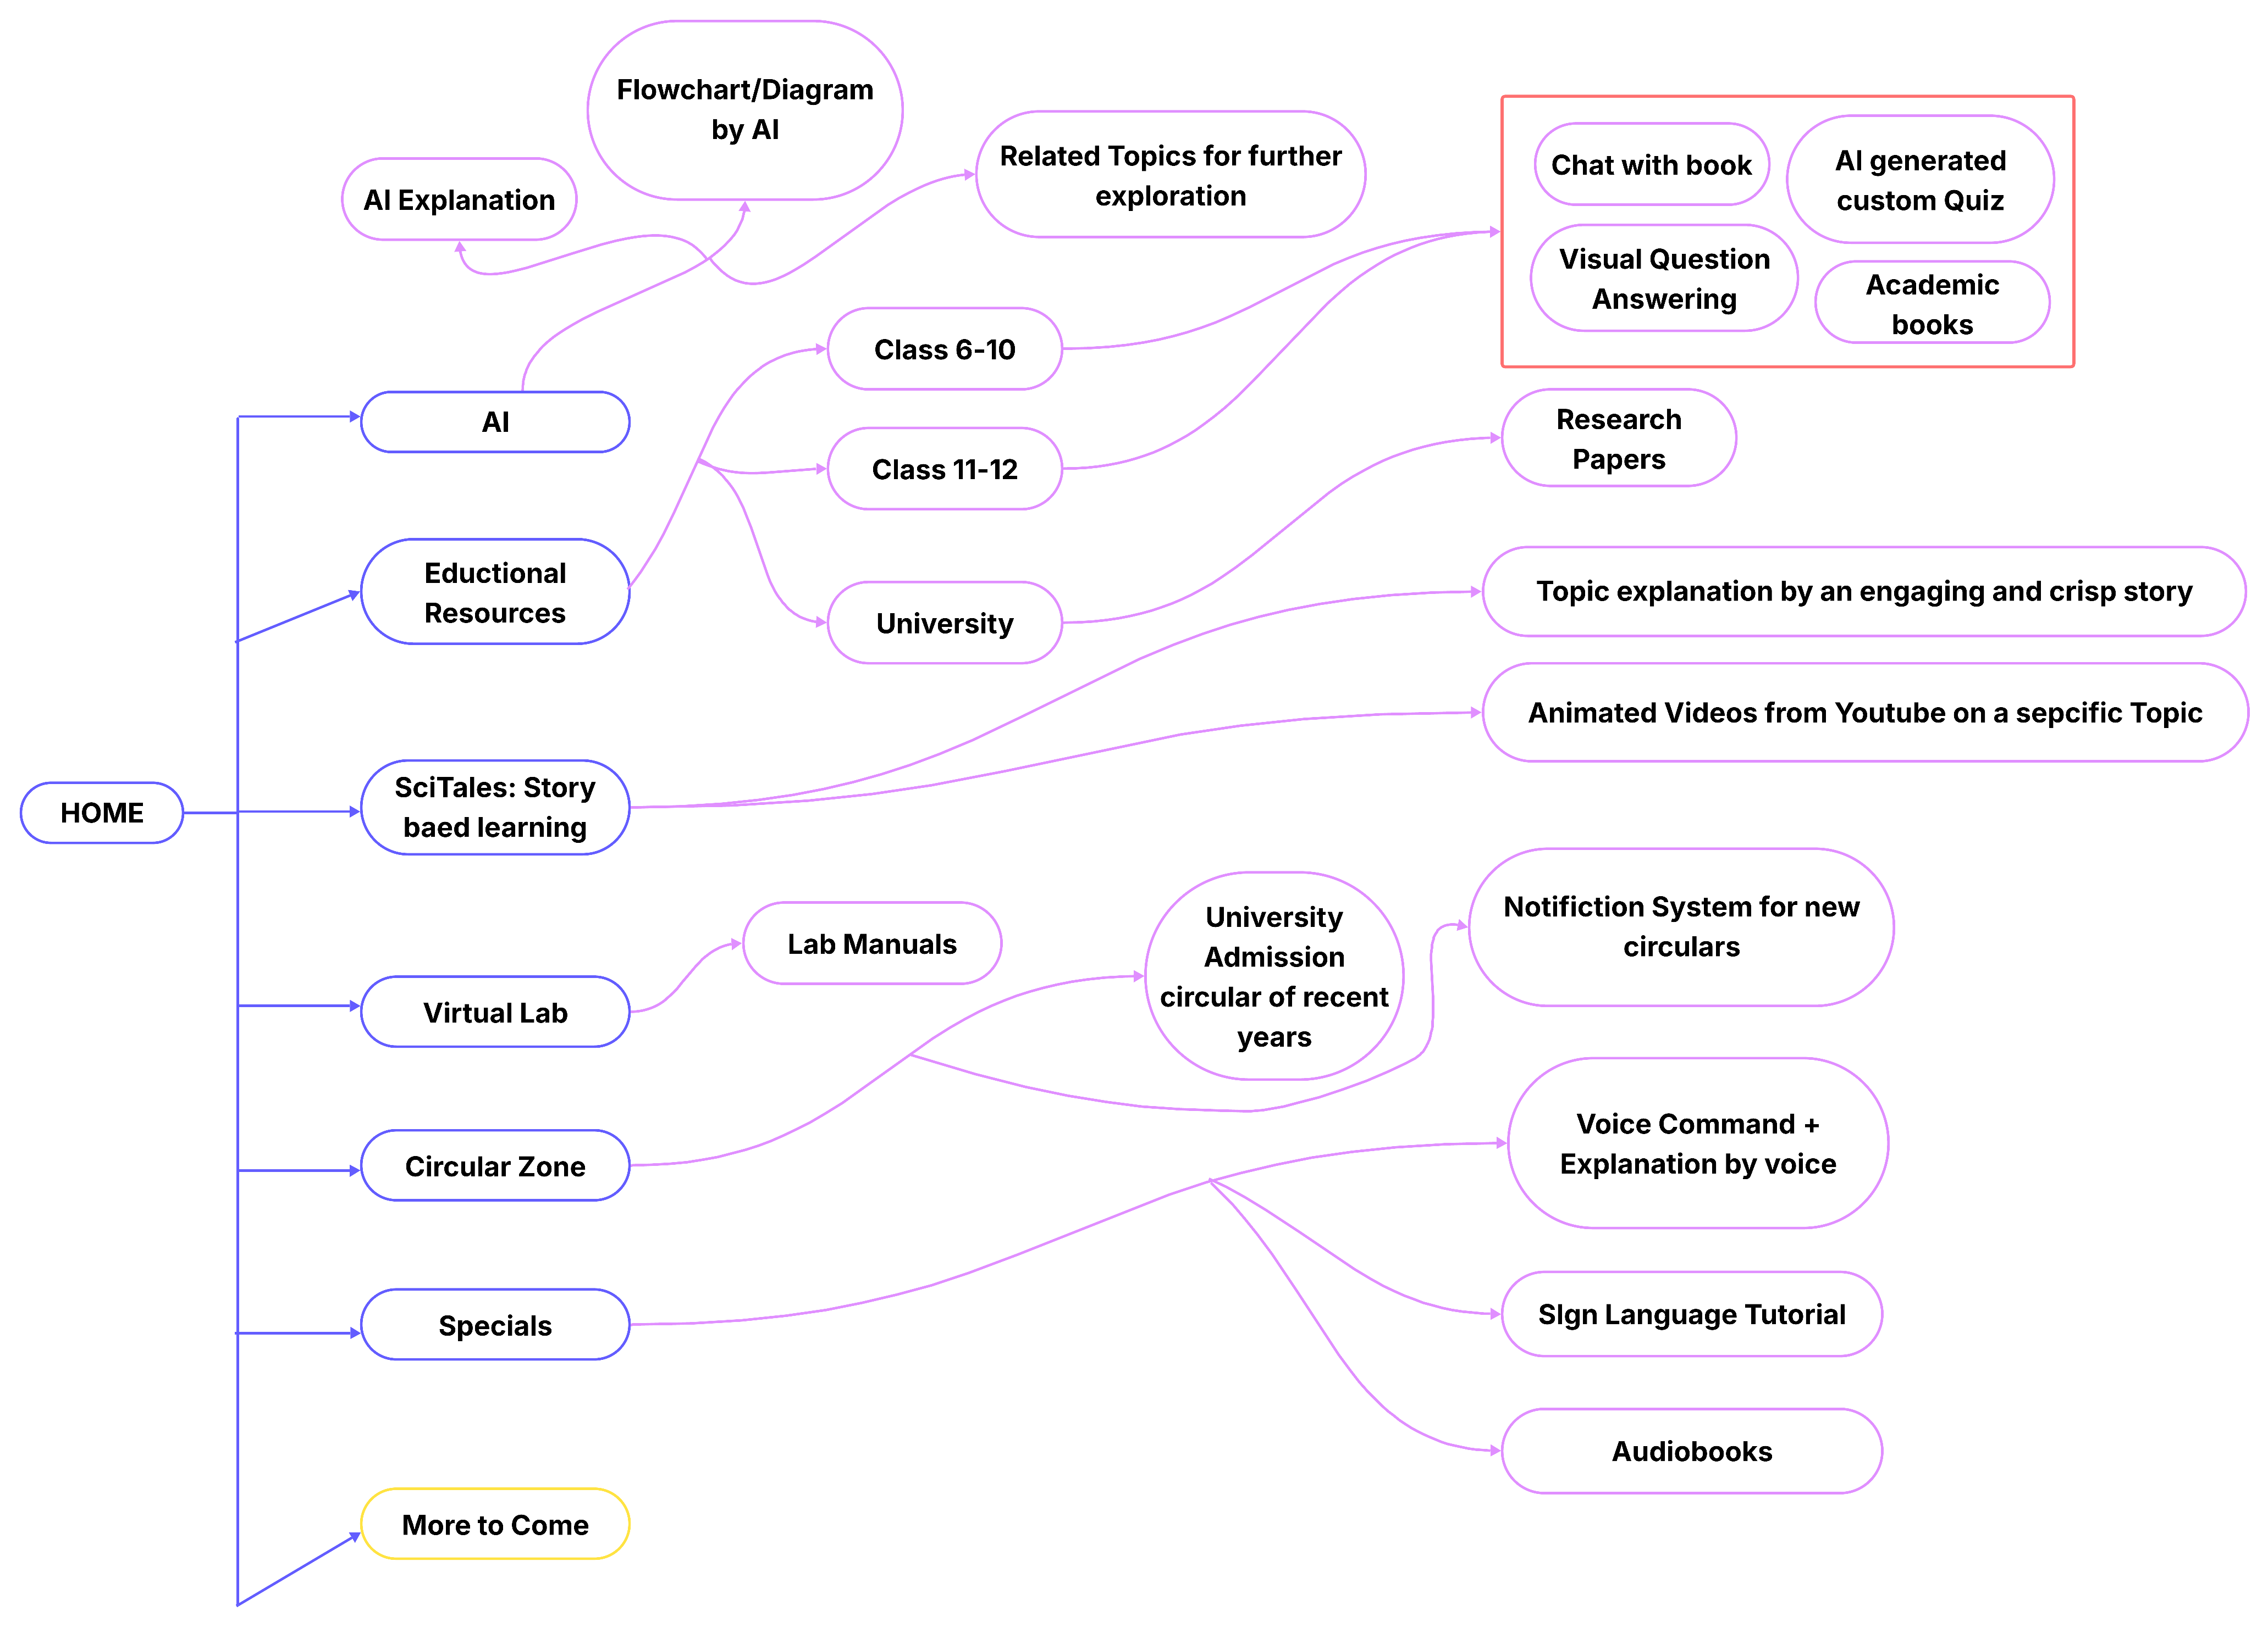
SITE MAP

